Slide 1
International eLearning University
Hossein Akhlaghpour
ObjectJ Inc.
hossein@objectj.com

Slide 2
Outline
Introduce e-Learning
Introduce ObjectJ
Market Analysis
Internationalization of eLearning
Future Trend of eLearning
Fermat Learning Group
Conclusion

Slide 3







History of eLearning
Since 1998
eLearning in Industry & Academy

Slide 4




eLearning Process
Content
Progress
Report
Author
Content
Progress
Report
Live
Instructor
Student

Slide 5
eLearning Components
Mentoring
eLearning
Tools
eCourse
Development

Slide 6
eLearning Tools
Other IT Systems
(HR, Finance)
LCMS
Authoring
Tools
Assessment
Tool
Virtual
Classroom

Slide 7
eLearning
Process / Tool mapping
Authoring
Tool
Assessment
Tool
Author
LCMS
Virtual Classroom
Instructor
Student

Slide 8


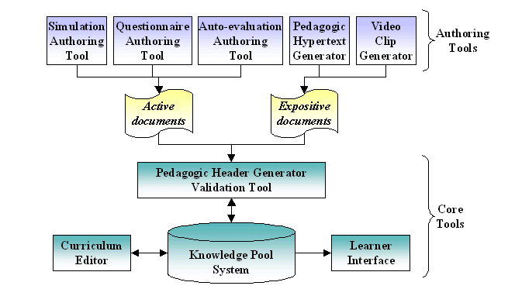




eLearning Standards
IMS Content Packaging (IMS CP)
IMS Digital Repositories Specification
IMS Enterprise Specification
IMS Learner Information Package (IMS LIP)
IMS Learning Design Specification
IMS Question & Test Interoperability (IMS QTI)
IMS Reusable Definition of Competency or Educational Objective (IMS RDCEO)
IMS Simple Sequencing Specification

Slide 9
eCourse Development
eCourse units = SCO
(Sharable Courseware Object)
Every unit takes about 5 minutes
1 hour of an eCourse ~ 3 to 4 hours of a conventional course

Slide 10
eLearning Standards
LMS
AICC
LMS
Content
Distributor
Content
Provider
SCORM
LMS
LMS

Slide 11






Multi-Source course development using SCORM
University
University
University
University

Slide 12




Mentoring System
instructor
TA
TA
Student

Slide 13








ObjectJ History
1999 – Starting as consultant in eLearning business.
2000 – Work with ISOPIA to develop the first J2EE e-Learning application
2001 – Develop mobile e-Learning solution
2003 – Released e-Learning suite of products
2004 – Develop the first online university in Iran

Slide 14
ObjectJ eLearning System
ObjectJ
LCMS
ObjectJ Assessment
Tool
ObjectJ Virtual Classroom
ObjectJ Authoring
Tool
ObjectJ Mobile Learning
ObjectJ eLearning System

Slide 15
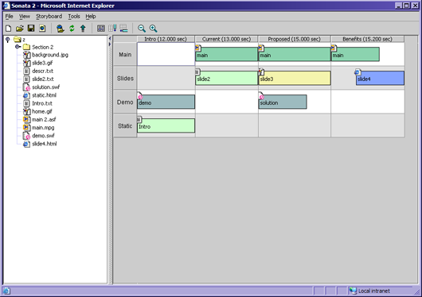

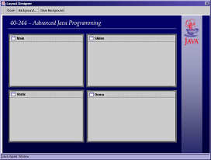

ObjectJ Authoring Tool
Synchronization
and Timing
Storyboard
Content
Material
Visual Layout
Asset
Browser
Layout
Designer

Slide 16
ObjectJ LCMS
Admit students (Admission)
Assign students to departments
Assign courses to departments
Determine the course hierarchy: prerequisite between courses
Register courses for students or allow them to register courses considering their hierarchy
Track student's usage (whether student has viewed lessons)
Provide more than 50 reports for administrators.

Slide 17
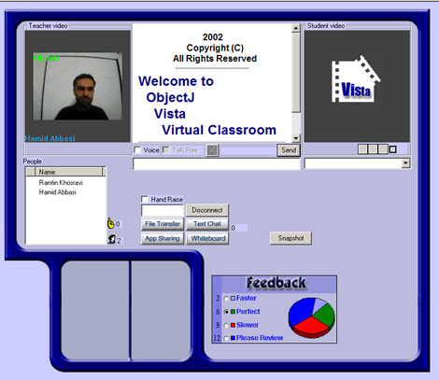


ObjectJ Virtual Classroom
Student
Video
Instructor
Video
Professional
Services
Students
List
Class
Feedback

Slide 18
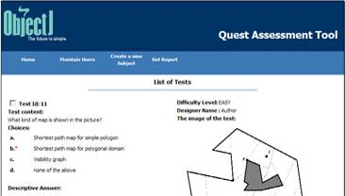
ObjectJ Assessment Tool
Adaptive Testing Difficulty
Random Exam Generation
Powerful Reporting
Several Kinds of Tests

Slide 19




ObjectJ Mobile Learning
`
Content
SCORM-compliant
LMS
nextMove
Synchronization
Tool
Progress
Content
(online mode)
Content
nextMove
Embedded
LMS
(eLMS)
Sonata
Authoring
Tool

Slide 20




ObjectJ Customers / Partners
Customers
Partners

Slide 21
International e-Learning
Market Analysis
Only in Iran:
1.5 million candidates / year
About 1 million candidate cannot enter any Universities
Average fee of $2000 / student / year
$2 billion market
Add China, India, Arab countries =>
The market is unlimited
(not even including African countries & poor countries like Afghanistan)

Slide 22
eLearning in Iran
3000 students in University of Tehran took 5 courses in a blended eLearning format
University of Elmosanat is taking more than 2000 eLearning students this year with about 50 TAs.
More than 100,000 hours of eLearning courses is seen by student in the last 6 months
We predict the number of students increases to 10,000 by end of 2006

Slide 23
Why ObjectJ
Cost effective
Access Network of Universities in the middle east
Local Support
First company who offered online university in the middle east in large scale

Slide 24

Largest eLearning School
3000000 students
Online university surpasses the conventional one
50 different courses
Almost all of courses are MBA and IT courses

Slide 25
Fermat Learning Group Objectives
Provide high quality blended eLearning solutions to countries with a demand for higher education and will serve to streamline existing eLearning opportunities provided by top universities across the world.

Slide 26

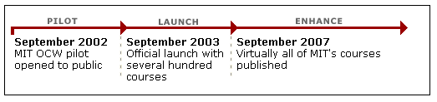
Open Courseware Project
Aeronautics & Astronautics
Anthropology NEW
Biology
Chemical Engineering
Chemistry
Civil & Environmental_x000b_Engineering
Comparative Media Studies NEW
Earth, Atmospheric, &_x000b_Planetary Sciences
Economics
Electrical Engineering &_x000b_Computer Science
Engineering Systems Division b
History NEW
Linguistics & Philosophy
Literature NEW
Materials Science &
Engineering NEW
Mathematics
Mechanical Engineering
Nuclear Engineering NEW
Ocean Engineering
Physics
Political Science
Sloan School of Management
Urban Studies & Planning

Slide 27

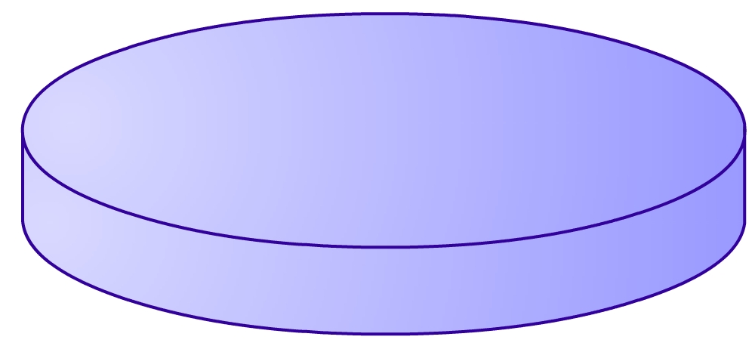
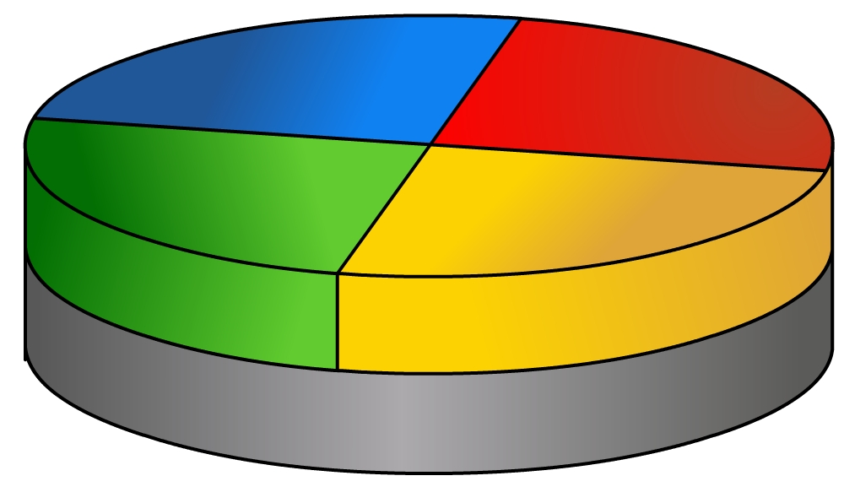
Future Course Development
Part-X
courseware
Part-Y
Syllabus is changing!
Part-Z
Part-W
Extended CourseWare
Extended CourseWare
Open CourseWare

Slide 28
Dynamic Nature of eLearning
You can mix & match different courses and create new course
You can mix & match courses from different dept and create new majors
You can mix & match eLearning with conventional learning and create more efficient blended eLearning

Slide 29
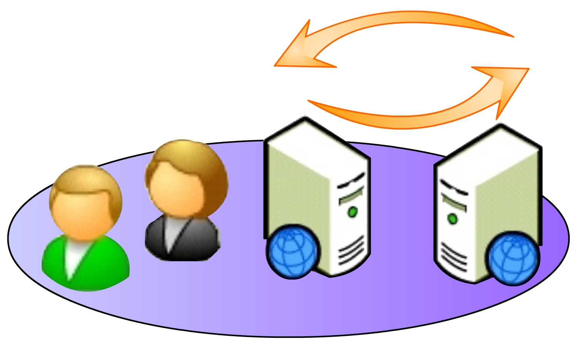
University Collaboration Framework
Learning Group
Learning Group
Open CourseWare

Slide 30




Fermat Learning Group
Vision
TOEFL
HOST
Provider

Slide 31
Fermat Learning Group Admission Process
Admission
Host-
Theoretical
Provider-
Theoretical
Fail/ Pass
Fail/ Pass
Host-
Theoretical
TOEFL
Admission
Host-
Experimental
Host-
Experimental

Slide 32






Delivering high quality courses
Application Server
internet
Local Server

Slide 33


Future Course Distribution
internet
Application Server
Coffee-net

Slide 34
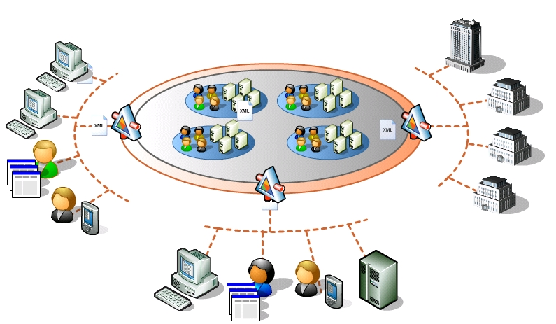
No more eLearning

Slide 35
Conclusion
Internationalization of eLearning is unavoidable
Open courseware program is a base for future eLearning infrastructure
Learning groups is the base for exchanging programs and offering courses to multinational students (via host universities)
The best eLearning university will be recognized by the quality of their mentoring systems & students
Eventually there won’t be any line between eLearning and conventional learning such that they merge together

